Slide 1
Agricultural & Natural Resources Policy internship program
Spring 2017 Recruitment

Slide 2

Program Overview
Overview
Ag policy-focused internships
Full semester, all three terms (summer, fall, and spring)
Only for College of Agriculture & Life Sciences students
Locations
Washington, D.C.
Rome, Italy
Austin, Texas
  Legislative sessions only
History
Established spring 1990
Dr. Ron Knutson, an AGEC professor, founded the program
Over 900 alumni

Slide 3



LOCAtions
Austin, Texas
Hosting Organizations may include:
Legislative Offices
State Agencies that focus on Ag & Natural Resources
Washington, D.C.
Hosting Organizations may include:
Congressional Offices
House Committee on Agriculture
National Farmers Union
National Association of Wheat Growers
Rome, Italy
Hosting Organization:
Food & Agriculture Organization (FAO) of the United Nations

Slide 4

Program benefits
 | Paid Internship | Housing Provided | Scholarship | Academic Credit | Networking | Resume Building | Training & Support | Knowledge of Policy Process
Washington, D.C.
Austin, TX
Rome, Italy
$500/month
$1000/month
$2000 su, $2500 sp/fa

Slide 5
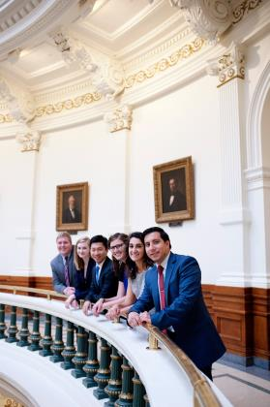
Basic eligibility
Be a U.S. citizen; permanent residents are not eligible.
Be in good academic and conduct standing at TAMU.
Minimum 2.25 cumulative GPR; 2.5 preferred.
Possess valid health insurance during the internship.
Currently enrolled as an undergraduate, master’s, or Ph.D. student in the College of Agriculture & Life Sciences.
Be able to attend all pre-departure events in College Station, Texas.
*some variation on eligibility exists by location, please visit website for details.

Slide 6
Application deadlines
Austin, Texas
Term(s) Offered:
Applications for the spring 2019 legislative session will open in August 2018.
Washington, D.C.
Term(s) Offered:
  Summer 2017 – application due February 24, 2017
  Fall 2017 – application due February 24, 2017
  Spring 2016 – application opens August 2017
Rome, Italy
Term(s) Offered:
  Summer 2017 – application due February 24, 2017
  Fall 2017 – application due February 24, 2017
  Spring 2018 – application opens August 2017

Slide 7






Connect with us
Website: anrp.tamu.edu
Email: anrp@tamu.edu
Phone: 979.845.3712
Office: Suite 515, Agriculture & Life Sciences Building
Instagram: @tamupolicyinterns
Twitter: @tamuANRP
Facebook: @tamuANRP

Slide 8


Questions?
#AggiesImpactPolicy
#AggieInternLife

