Slide 1
Agricultural & Natural Resources Policy internship program

Slide 2
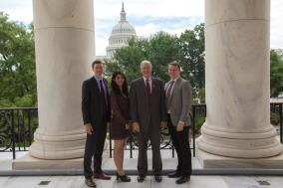
agenda
Program Overview
Program Benefits
Basic Eligibility
Application Components
Selection & Placement Processes
Meet Former Interns – if applicable
Question & Answers
Connect with Us

Slide 3
Program Overview
Overview
Ag policy-focused internships
Full semester, all three terms (summer, fall and spring)
Only for College of Agriculture & Life Sciences students
Locations
Washington, D.C.
Rome, Italy
Austin, Texas
Legislative sessions only
History
Established spring 1990
Dr. Ron Knutson, an AGEC professor, founded the program
Over 900 alumni

Slide 4
LOCAtions
Austin, Texas
Hosting Organizations may include:
Legislative Offices
State Agencies that focus on Ag & Natural Resources
Washington, D.C.
Hosting Organizations may include:
Congressional Offices
House Committee on Agriculture
National Farmers Union
National Association of Wheat Growers
Rome, Italy
Hosting Organization:
Food and Agriculture Organization (FAO) of the United Nations

Slide 5
Program benefits
 | Paid Internship | Housing Provided | Scholarship | Academic Credit | Networking | Resume Building | Training & Support | Knowledge of Policy Process
Washington, D.C.
Austin, TX
Rome, Italy
$500/month
$1000/month
$2000 su, $2500 sp/fa

Slide 6
Basic eligibility
D.C. & Austin – must be a U.S. citizen
Permanent residents &/or international students may apply for the Rome program.
Be in good academic and conduct standing at TAMU.
Minimum 2.25 cumulative GPR; 2.5 preferred.
Possess valid health insurance during the internship.
Currently enrolled as an undergraduate, master’s, or Ph.D. student in the College of Agriculture & Life Sciences.
Be able to attend all pre-departure events in College Station, Texas.
*some variation on eligibility exists by location, please visit website for details.

Slide 7
Application deadlines
Austin, Texas
Term(s) Offered:
Applications for the spring 2019 legislative session will open in August 2018.
Washington, D.C.
Term(s) Offered:
Summer 2018 – application due February 23, 2018
Fall 2018 – application due February 23, 2018
Spring 2019– application opens in August 2018
Rome, Italy
Term(s) Offered:
Fall 2018 – application due February 23, 2018
Spring 2019– application opens in August 2018
Summer 2019– application opens in August 2018

Slide 8
Application components
A completed location-specific ANRP Internship Program Application
Cover Letter and Professional Resume
Policy/Issue Essay
Location specific
Official college transcript(s)
Transfer transcript only required if student is in first semester at A&M
Two (2) letters of recommendation

Slide 9
Selection process
Austin, Texas
1. Completed Application
3. 15-minute Faculty & Staff Interview
Rome, Italy
1. Completed Application
2. Sign-up for Interview
4. Applicant Notification
5. Finalist Briefing
6. Finalist Interviews w/ Hosting Offices & Donors
7. Applicant Notification
4. Applicant Notification
3. 15-minute Faculty & Staff Interview
2. Sign-up for Interview
5. Securing an Internship
Washington, D.C.
1. Completed Application
2. Sign-up for Interview
3. 15-minute Faculty & Staff Interview
4. Applicant Notification
5. Finalist Briefing
6. Finalist Interviews w/ Hosting Offices & Donors
7. Applicant Notification

Slide 10
Questions & answers
What questions do you have?

Slide 11
Connect with us
Website: anrp.tamu.edu
Email: anrp@tamu.edu
Phone: 979.845.3712
Office: Suite 515, Agriculture & Life Sciences Building
Instagram: @tamupolicyinterns
Twitter: @tamuANRP
Facebook: @tamuANRP

Slide 12
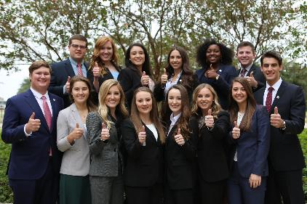
Questions?
#AggiesImpactPolicy
#AggieInternLife

