Slide 1
Predispositions for Participation
in High-Impact Practices
Dustin K. Grabsch, Director, Academic Initiatives, Southern Methodist University
Stephanie Webb, Director, Policy Internship Programs, Texas A&M University

Slide 2
Program Outline
Welcome, Introduction, & the Why (2 min)
Background (8 min)
National Survey on Student Engagement
Types of HIPs
Characteristics / Connections to Student Success
Discussion (5 mins)
Study I: Long-term Effects of Participating (15 min)
Study II: Pre-Dispositions (15 min)
Why are they and are they not participating?
Decision-Making Methods
Discussion (10 min)
Closing and Questions (5 min)
HIPS IN THE STATES CONFERENCE // 2
Notes:
Dustin

Slide 3
HIGH IMPACT EDUCATIONAL PRACTICES
Notes:
Dustin

Slide 4
Review of the Literature
Several studies have been conducted to describe and assess the impact of various high-impact practices including:
learning communities (Hall & O’Neal, 2016; Inkelas & Weisman, 2003; Miller, Rycek, & Fritson, 2011; Pike, 1999; Stassen, 2003; Zhao & Kuh, 2004),
service learning (Miller et al., 2011),
study abroad (Stebleton, Soria, & Cherney, 2012),
undergraduate research (Lopatto, 2010; Miller et al., 2011),
internships (Miller et al., 2011; O’Neill, 2010), and
capstone courses.
However, as Brownell and Swaner (2009) noted,
Most studies look at student performance over a very short span of time (typically from the first to the second semester, or from the first year of college to the sophomore year), there is a troubling lack of longitudinal data on high-impact activities. (p. 27)
HIPS IN THE STATES CONFERENCE // 4

Slide 5
RESEARCH STUDY

Slide 6
Purpose
The purpose of this study is to examine the long-term impacts on students who have participated in a variety of high impact experiences
internships
study aboard
undergraduate research
capstone course with project
learning community
Specifically the program leaders explored the long-term impacts of learning and development that occurred due to their participation in an educationally purposeful activity (Study I). And, sought to examine the predisposition/decision-making process and potential barriers for student participation. (Study II).
HIPS IN THE STATES CONFERENCE // 6

Slide 7
Included Programs
Undergraduate Research Scholars (URS)
HIPS IN THE STATES CONFERENCE // 7

Slide 8
Methods
qualitative research paradigm (Lincoln & Guba, 1985)
multiple programs and researchers working as a research team
seven different high impact programs that had been in existence between 10-30 years
sampling challenge, due to changing contact information with former students
purposive sampling by program and demographics
sex
years out of program
first-generation
race
reached data saturation (23 respondents)
emailed to schedule a 45 minute interview
demographic questionnaire utilized
Audio recorded, and transcribed
HIPS IN THE STATES CONFERENCE // 8
Notes:
Methods Continued.
An open-coding analysis was used to determine emerging themes and patterns based upon reflections by the participant.
Data themes and categories were interpreted by the research team through triangulation and consensus-building.
Each unit (idea) was initially listed, without placement into categories.
Tacit knowledge was employed in making initial judgments for categorization.
Colored markers were used to identify themes so that the data could remain in context and provide a visual indication of emerging categories (Dooley, 2007)
Credibility in this study was achieved with peer debriefing (analyzing scripts and coming to consensus on emerging categories).
To ensure transferability, the researchers reported the findings using quotes from the participants. Data was also traceable to the original data sources using an audit trail for dependability and confirmability (Erlandson, Harris, Skipper, & Allen, 1993).
Individual, Semi-Structured Interviews
Research questions included statements such as:
Tell me about your experience within this program
What are you most vivid experiences and why
Share additional experiences you may have sought as a result of participating in this program
How did this experience impact the rest of your undergraduate/graduate experiences…
until graduation
a few years after your degree
and long-term?

Slide 9
Questions Related to Decision Making
What attracted you to participate in the program?
Describe any hesitations or barriers for you participating in the program/experience - if any.
What would you say most influenced your decision to participate in the program?
HIPS IN THE STATES CONFERENCE // 8

Slide 10
Note on Limitations
An important limitation acknowledged by the researchers is:
participants are former students who ultimately partook in a high-impact educational practice.
students who did not or were not able to overcome the barriers for participation are outside the population frame of the larger study.
Time out of program and its impact on participant memory
Relevancy to today of themes from 5+ years out of program
HIPS IN THE STATES CONFERENCE // 9

Slide 11
PARTICIPANTS

Slide 12
Pseudonym | Program | Age | Race | Gender | Education | Socioeconomic | Geography | Fgen | TF | Corps | Grad | TtD | Time Out
Sue | ANRP | - | White | Female | Doctorate | Lower middle class | Rural | No | No | No | Yes | On-time | 20
Nash | L3C | 24 | White | Female | Master | Upper middle class | Rural | No | No | No | Yes | On-time | 6
Bryan | ANRP | 28 | White | Male | Master | Lower middle class | Rural | No | No | No | Yes | Late | 6
BAJ | ANRP | 42 | White | Male | Master | Upper class | Suburban | No | No | Yes | Yes | Late | 20
Vivian | L3C | 28 | White | Female | Bachelor | Upper middle class | Suburban | No | No | No | Yes | On-time | 3
Laura | ANRP | 39 | White | Female | Professional | Upper middle class | Suburban | No | No | No | Yes | On-time | 12
Rex | ANRP | 38 | White | Male | Master | Upper middle class | Rural | No | No | No | Yes | Ahead of schedule | 17
Bryan | ANRP | - | White | Male | Bachelor | Upper middle class | Suburban | No | No | No | Yes | On-time | 1
Ginger | L.T. Jordan | 62 | White | Female | Doctorate | Lower middle class | Rural | No | No | No | Yes | On-time | 12
Joy | L.T. Jordan | 41 | White | Female | Master | Lower middle class | Suburban | No | No | No | Yes | On-time | 21
Cat | ANRP | 35 | White | Female | Doctorate | Upper middle class | Rural | No | No | No | Yes | On-time | 14
Michelle | University Scholars | 28 | White | Female | Bachelor | Working class | Suburban | Yes | Yes | No | Yes | Late | 1
Sixsmith | University Scholars | 24 | Asian, Asian American | Male | Bachelor | Upper middle class | Suburban | No | No | No | Yes | Ahead of schedule | 1
Lisa | University Scholars | 26 | Latino/a, Hispanic | Female | Graduate | Lower middle class | Urban | No | No | No | Yes | Ahead of schedule | 1
Robert | PPIP | 25 | White | Male | Bachelor | Lower middle class | Suburban | No | No | No | Yes | Ahead of schedule | 3
Mark | PPIP | 27 | White | Male | Bachelor | Upper middle class | Suburban | Yes | No | No | Yes | Late | 8
Elizabeth | PPIP | 23 | White | Female | Bachelor | Upper middle class | Rural | Yes | No | No | Yes | Ahead of schedule | 2
Ari | PPIP | 27 | Latino/a, Hispanic | Female | Master | Lower middle class | Urban | No | No | No | Yes | Late | 5
Leslie Knope | PPIP | 37 | White | Female | Master | Upper middle class | Suburban | Yes | No | No | Yes | Late | 15
Alexandre Dumas | COALS | 28 | Latino/a, Hispanic | Male | Bachelor | Lower middle class | Rural | Yes | No | Yes | Yes | Late | 1
Jake P. | COALS | 24 | White | Male | Master | Working class | Rural | No | No | No | Yes | Ahead of schedule | 4
Matt | COALS | 25 | White | Male | Bachelor | Upper middle class | Suburban | No | No | No | Yes | On-time | 4
Robert Wilson | COALS | 32 | White | Male | Master | Lower middle class | Rural | No | No | No | Yes | Late | 1
Notes:
Employment Status
Time Out from the Program

Slide 13
FINDINGS

Slide 14
Study 2: Findings
Major themes of predisposition included:
Awareness: many citing individuals who informed or encouraged them to apply/participate.
Interest: opportunities to work toward/explore college or career goals, a way to connect with like-minded people on campus, and an opportunity to distinguish themselves academically and professionally.
Hesitations: Respondents discussed barriers to participation, finances and academics being a key theme. Predisposition findings ranged from students having no initial interest or knowledge of participating in the program(s) to intentionally seeking out the program(s) as part of the their college experience.
HIPS IN THE STATES CONFERENCE // 13

Slide 15
Findings: Awareness
Respondents voluntarily disclosed how they “first heard” of the program(s), citing traditional marketing and recruitment methods such as:
Mailings
postings on bulletin boards
class presentations
word-of-mouth.
In fact, when asked what attracted her to the University Scholars Program, Alaina said, “Being made aware of it in the first place. I was not aware of it.”
HIPS IN THE STATES CONFERENCE // 14
Notes:
The researchers found that many students became attracted to programs through word-of-mouth or faculty and peer encouragement to participate. This personal connection included established relationships such as family members and faculty as well as non-established relationships such as classmates. In fact, 57% (n = 12) of the respondents cited a person or people who helped encouraged participation. This encouragement was both direct and indirect. An example of direct encouragement is parents who had worked in higher education and understood the benefits of participating in HIPs, or an aunt who had traveled extensively and volunteered to pay for the student’s study abroad. Lisa with the University Scholars program said, “I saw it as a chance to do something a little more… to take it to the next level. My professor pushed me a little bit further.” Indirect encouragement came in the form of such things as knowing a friend of a friend who participated in the program previously and talked highly of the experience, or the student heard about the program(s) at an event or an on-campus resource table. For example, Cat said, “Friends on campus had participated in the past and talked about it”, making her “less afraid of the opportunity,” referring to the ANRP Internship Program.

Slide 16
Findings: Interest
Other respondents saw participation in the program(s) as a way to connect with a group or as a way to distinguish themselves.
Nash with L3C said “I wanted to be very intentional about my time at Texas A&M.”
David, with University Scholars said that the program “Stood out to me because the students seemed excellent. I wanted something like that.”
Complementing that statement, Rex (ANRP Internship Program) said he liked the competitiveness and prestige of the program.
Other respondents saw participation in the program(s) as a means to an end – that participating in these programs would help them reach specific goals in or beyond college.
HIPS IN THE STATES CONFERENCE // 15
Notes:
Ginger (L.T. Jordan Institute) said, specifically “...one of my goals was to go to Australia”, while Joy with the L.T. Jordan Institute said, “I was interested in experiences in another country that were facilitated through a university program.” Others cited specific career goals as a reason for participating in HIPs. They wanted help identifying career opportunities, help working toward career goals, or to add something meaningful to their resume. Alexandre with COALS Academic Programs said, “I wasn’t really sure what I was going to do with my career. I knew I liked my major, but I wasn’t sure what I was going to do in the field because it was so broad.” Mark with PPIP said he was interested in partaking in “work that I thought was well aligned with my passions and talents”. Lastly, Alaina said she participated in University Scholars because, “It was an opportunity to see if this was something I wanted to do before I took the plunge into 2.5 years of doing research.”

Slide 17
Findings: Hesitation
When asked about specific barriers to participation, responses ranged.
Some respondents cited having no barriers to participation, such as Vivian (L3C) who said, “I don’t remember having any hesitations” and David (University Scholars) who said, “No, I didn’t [have any hesitations]. It was something I was very excited about.”
However, others cited:
finances
lack of confidence
academics, and
uncertainty
HIPS IN THE STATES CONFERENCE // 16
Notes:
However, others cited finances, lack of confidence, academics, and uncertainty has barriers to participation. For example on confidence, Joy with L.T. Jordan Institute recalls thinking, “Oh my gosh, what am I doing?” And, Alaina with University Scholars said, “Um, to take on something like this as well as a little intimidating.” Students were concerned about academics and time to graduation. Sue (ANRP Internship Program) said she had a “reservation about being gone the fall of my senior year.” Nash with L3C said, “The big reason I decided to participate was because two of the courses were required as part of my major and I wanted to be intentional about my time [in college]”. The most prominent and pervasive barrier across many of the programs was the financial burden and considerations. 62% (n =13) of respondents cited cost as an issue. Interestingly, some respondents recognized and mentioned that cost could have been an issue, even if their family could afford it. There was a definite recognition of the barrier.

Slide 18
Conclusion/Recommendations
Findings from this research study can be helpful for university faculty, HIP program administrators, and student affairs professionals.
Better articulate a worth ratio for participation
Ensure that HIP programs aid in fulfillment of academic degree requirements
0-credit, proficiencies, required internships, etc.
Make concerted marketing efforts to overcome perceived barriers
“too expensive”, “never left [state]”, “I’m not worthy”
HIPS IN THE STATES CONFERENCE // 17
Notes:
For example, knowing that a university scholars program can sometimes be perceived as “too prestigious” can help prompt program administrators to frame their recruitment efforts in a way that is not so elitist. Or, for programs that are costly due to time away from campus, program administrators can find ways to reduce costs or to help students identify additional funding sources.

Slide 19
DISCUSSION
What resonates with your professional practice?
What conclusions or recommendations could you draw from these studies to influence your practice?

Slide 20
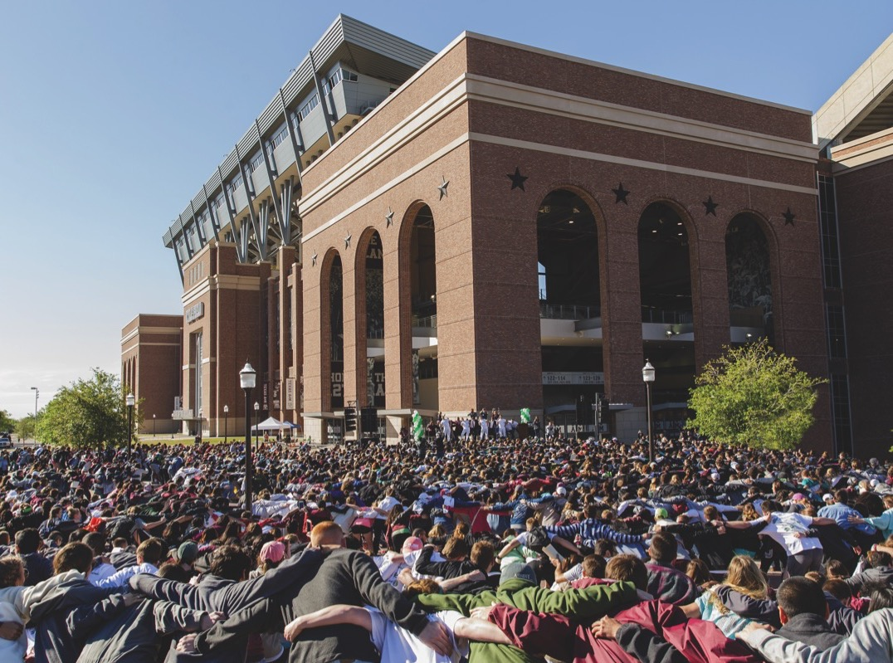
Questions & Answers
Dustin K. Grabsch Stephanie Webb
dgrabsch@smu.edu stephanie.webb@ag.tamu.edu

