Slide 1
Howdy!
Welcome to ANRP’s info session!
Here are some guidelines for this session:
Please make sure that you are using your full name and not a screen name. We are taking attendance and you will be removed if you are not identified.
All participants will be muted, and video disabled upon entry and throughout the session.
If you have questions, please submit them via the live chat.
Please be polite and respectful to all participants..
We will answer your questions live at the end of the full presentation as time allows.

Slide 2
Agricultural & natural resources policy internship program
anrp.tamu.edu

Slide 3
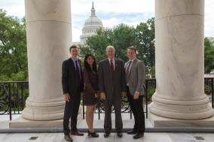
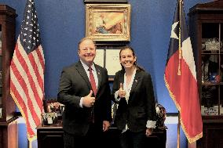
agenda
Program Overview
Program Benefits
Basic Eligibility
Application Components
Selection & Placement Processes
Question & Answers

Slide 4
Program overview
Overview
Ag policy-focused internships
Full semester, all three terms (summer, fall, and spring)
Only for College of Agriculture & Life Sciences students
Locations
Washington, D.C.
Rome, Italy
Austin, Texas
Legislative sessions only
History
Established spring 1990
Dr. Ron Knutson, an AGEC professor, founded the program
Over 1000 alumni

Slide 5
locations
Austin, Texas
Hosting Organizations may include:
Legislative Offices
State Agencies that focus on Ag & Natural Resources
Washington, D.C.
Hosting Organizations may include:
Congressional Offices
House Committee on Agriculture
National Farmers Union
National Association of Wheat Growers
Rome, Italy
Hosting Organization:
Food & Agriculture Organization (FAO) of the United Nations

Slide 6
Program benefits
 | Paid Internship | Housing Provided | Scholarship | Academic Credit | Networking | Resume Building | Training & Support | Knowledge of Policy Process
Washington, D.C.
Austin, TX
Rome, Italy
$500/month
$1000/month
$2000 su, $2500 sp/fa

Slide 7
Basic eligibility
D.C. & Austin – must be a U.S. citizen
Permanent residents &/or international students may apply for the Rome program.
Be in good academic and conduct standing at TAMU.
Minimum 2.25 cumulative GPR; 2.5 preferred.
Possess valid health insurance during the internship.
Currently enrolled as an undergraduate, master’s, or Ph.D. student in the College of Agriculture & Life Sciences.
Be able to attend all pre-departure events in College Station, Texas.
*some variation on eligibility exists by location, please visit website for details.

Slide 8
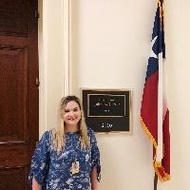
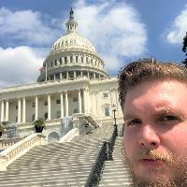
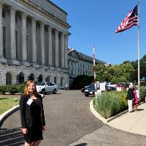
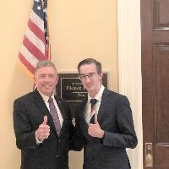
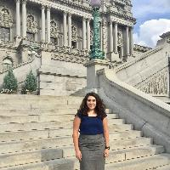
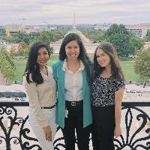
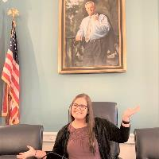
Aggies impact policy!
ENTO
AGEC
WFSC
NUTR
AGCJ
RPTS, AGBU, SCSC
ESSM
AGSC

Slide 9
Application components
A completed location-specific ANRP Internship Program Application
Cover Letter and Professional Resume
Policy/Issue Essay
Location specific
Official college transcript(s)
Transfer transcript only required if student is in first semester at A&M
Two (2) letters of recommendation

Slide 10
Selection process
Washington, D.C.
Rome, Italy
Austin, Texas
1. Completed application
1. Completed application
1. Completed application
2. Sign-up for interview
2. Sign-up for interview
2. Sign-up for interview
3. 15-minute interview with faculty, staff, & program donors
3. 15-minute interview with faculty, staff, & program donors
3. 15-minute interview with faculty, staff, & program donors
4. Applicant notification
4. Applicant notification
4. Applicant notification
5. Placement briefing
5. Placement meeting
5. Placement meeting
6. Securing an internship
6. Securing an internship
6. Securing an internship

Slide 11
Application deadlines
Austin, Texas
Term(s) Offered:
Spring ‘23 – applications open August ‘22
Washington, D.C.
Term(s) Offered:
Spring ‘22 – applications due September 17
Summer ’22 – application opens January ’22
Fall ’22 – application opens January ‘22
Rome, Italy
Term(s) Offered:
Spring ‘22 – not offered
Summer ’22 – application opens early January ‘22 pending updates from the hosting organization & the host country
Fall ’22 – application tentatively opens January ‘22

Slide 12
Meet our former interns
What questions do you have?

Slide 13
Connect with us
Website: anrp.tamu.edu
Email: anrp@tamu.edu
Phone: 979-845-3712
Office: Suite 515, Agriculture & Life Sciences Building
Instagram: @tamupolicyinterns
Twitter: @tamuANRP
Facebook: @tamuANRP

