Slide 1
Policy internship programs
Become an Ambassador for Aggieland!
anrp.tamu.edu | ppip.tamu.edu

Slide 2
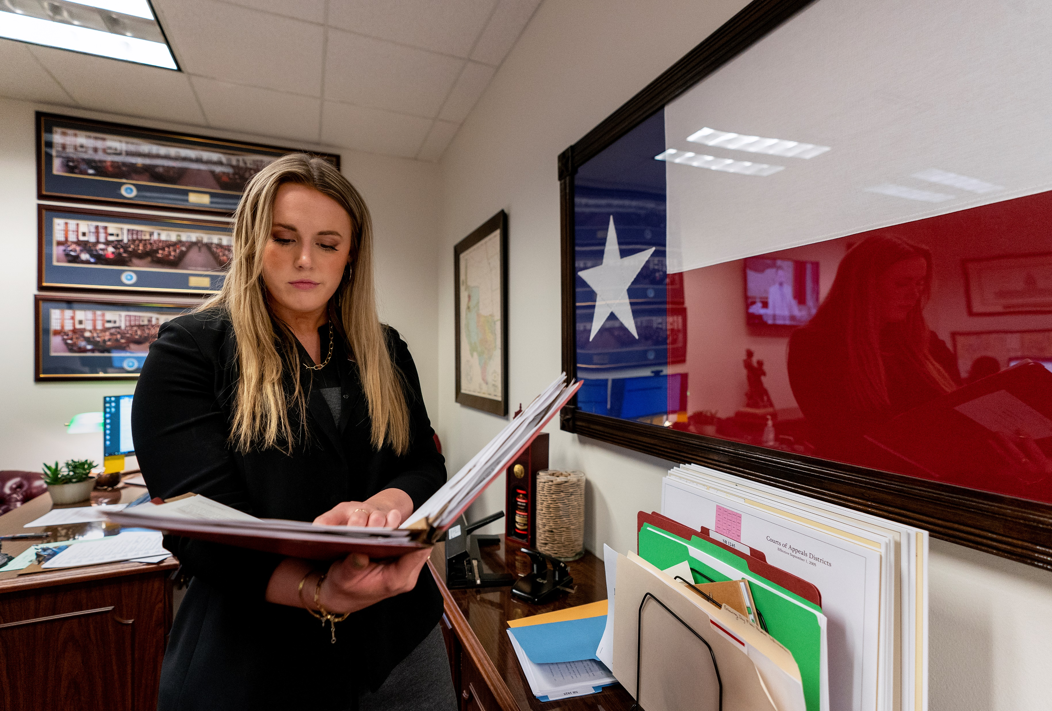
Two programs
Agricultural & Natural Resources Policy (ANRP) Internship Program
Ag & natural resource policy-focused internships
Exclusively for students majoring in the College of Ag & Life Sciences
Undergraduate & graduate
Spring, summer, & fall semesters
Established in 1990
Over 1000 program alumni
Public Policy Internship Program (PPIP)
Policy-focused internships
Open to all majors
Undergraduate & graduate
Spring, summer, & fall semesters
Established in 1999
Over 1000 program alumni

Slide 3
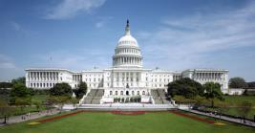
Aggie ambassador locations
Austin, Texas
(Legislative session only)
Legislative offices
State agencies
Advocacy groups
Washington, D.C.
Congressional offices
Federal agencies
Advocacy groups
Think tanks
Non-Government organizations
International Locations
PPIP offices:
U.S. Commercial Service (London, Madrid, and Paris)
CIFE - Centre international de formation européenne (Berlin)
IEP - Institut für Europäische Politik (Berlin)
ANRP office:
Food & Agriculture Organization (FAO) of the United Nations

Slide 4
Recent D.C. placements
Air Force Public Affairs
American Psychological Assoc.
American Public Human Services Assoc.
Association for Diplomatic Studies & Training
Bose Public Affairs Group
Congressional Coalition on Adoption Institute
Congressmembers Jodey Arrington, Lloyd Doggett, Eddie Bernice Johnson, Michael McCaul, Chip Roy, & Marc Veasey
Democratic National Committee
Embassy of Mexico
Family Research Council
FEMA
Global Cold Chain Alliance
Heritage Foundation
House Committee on Homeland Security
House Committee on Science, Space, & Technology (majority & minority offices)
Information Technology Alliance for the Public Sector (ITAPS)
International Justice Mission
National Academy for State Health Policy
National Conference of State Legislatures
Peace Corps
Senate Committee on Health, Education, Labor, & Pensions
Senate Republican Conference
Senators John Cornyn & Ted Cruz
TAMUS Federal Relations
The Wilderness Society
Todd Strategy Group
Torch .AI
White House Initiative on Education Excellence for Hispanics
White House Office of Science & Technology
Woodrow Wilson Center

Slide 5
Ag-specific opportunities (in D.C.)
American Seed Trade Association
Farm Credit Bank of Texas
Farm Credit Council
Fertilizer Institute
House Committee on Agriculture (majority & minority offices)
Lix Cap
National Association of State Departments of Agriculture
National Association of Wheat Growers
National Cattlemen’s Beef Association – Public Lands Council
National Council of Farmers Cooperatives
National Farmers Union
US Department of Agriculture – Communications team
U.S. Representatives from the Texas delegation

Slide 6
Recent D.C. placements – Cont.
Dept. of Commerce
Office of the Deputy Director General of the US & Foreign Commercial Service
Office of Strategic Partnerships
Office of Trade & Economic Analysis
Dept. of Energy
Office of Energy Efficiency & Renewable Energy
Office of Human Capital
Office of International Affairs
Dept. of Health & Human Services
Asst. Secretary for Preparedness & Response
Centers for Medicare & Medicaid Services
Global Affairs
Dept. of the Interior
National Parks Service
Dept. of Justice
Criminal Division of International Affairs
Human Rights & Specialty Prosecution
Legislative Affairs
Public Affairs
Dept. of State***
Bureau of Western Hemisphere Affairs Office of Policy
Dept. of Transportation
Maritime Administration
Office of the Inspector General
Environmental Protection Agency
Office of Air & Radiation
Office of Land & Emergency Management
Office of Water
U.S. Agency for International Development
Bureau of Economic Growth, Education, & Environment

Slide 7
Program benefits
 | Paid Internship | Housing Provided | Scholarship | Academic Credit | Networking | Resume Building | Training & Support | Knowledge of Policy Process
Washington, D.C.
Austin, TX
Europe
Varies by program
$1000/month
$2000 su, $2500 sp/fa

Slide 8
Basic eligibility
Be a U.S. citizen; permanent residents are not eligible*
Be in good academic and conduct standing at TAMU.
Cumulative college GPR requirements
ANRP – minimum 2.25, but 2.5 preferred
PPIP – minimum 3.0.
Possess valid health insurance during the internship.
Be able to attend all pre-departure events in College Station.
*some variation on eligibility exists by location, please visit websites for details.

Slide 9
Application deadlines
Austin, Texas
Both Programs
Spring ‘23
Applications due September 21
Washington, D.C.
ANRP
Spring ‘23
Applications due October 5
PPIP
Spring ‘23
Applications due September 21
International
ANRP
Spring ‘23
Applications due September 16
PPIP
Restarting our programs in Berlin, London, Madrid, and Paris will be dependent upon updates from each of our partnering offices.

Slide 10
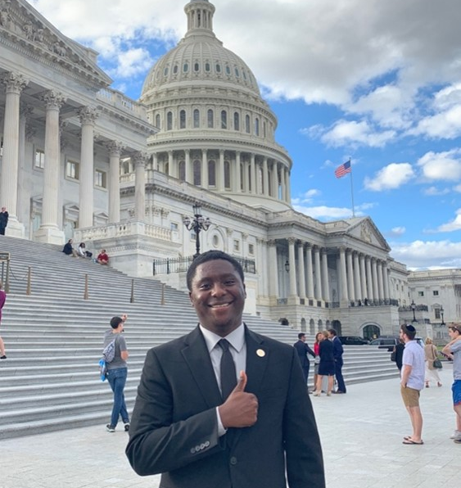
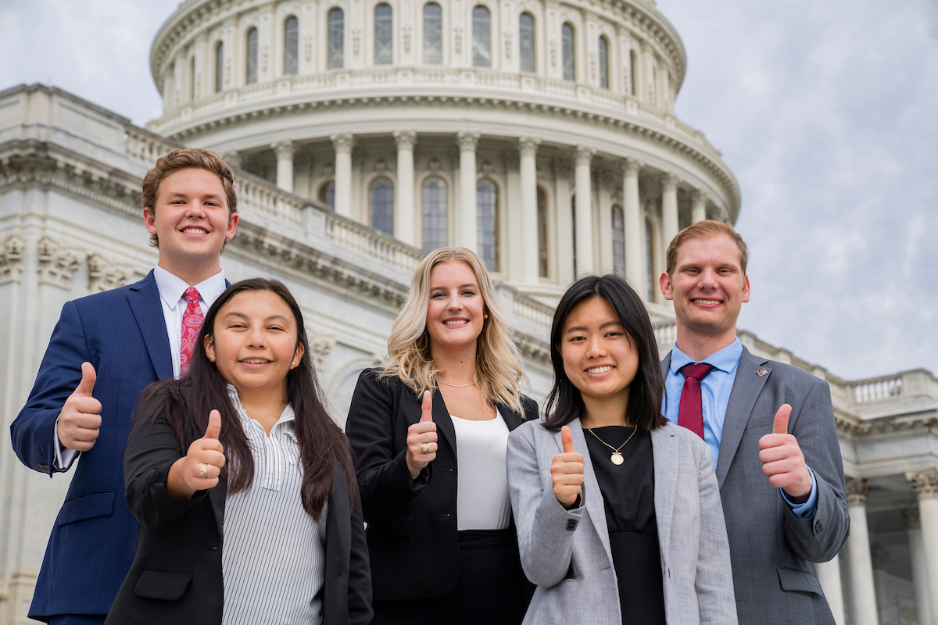
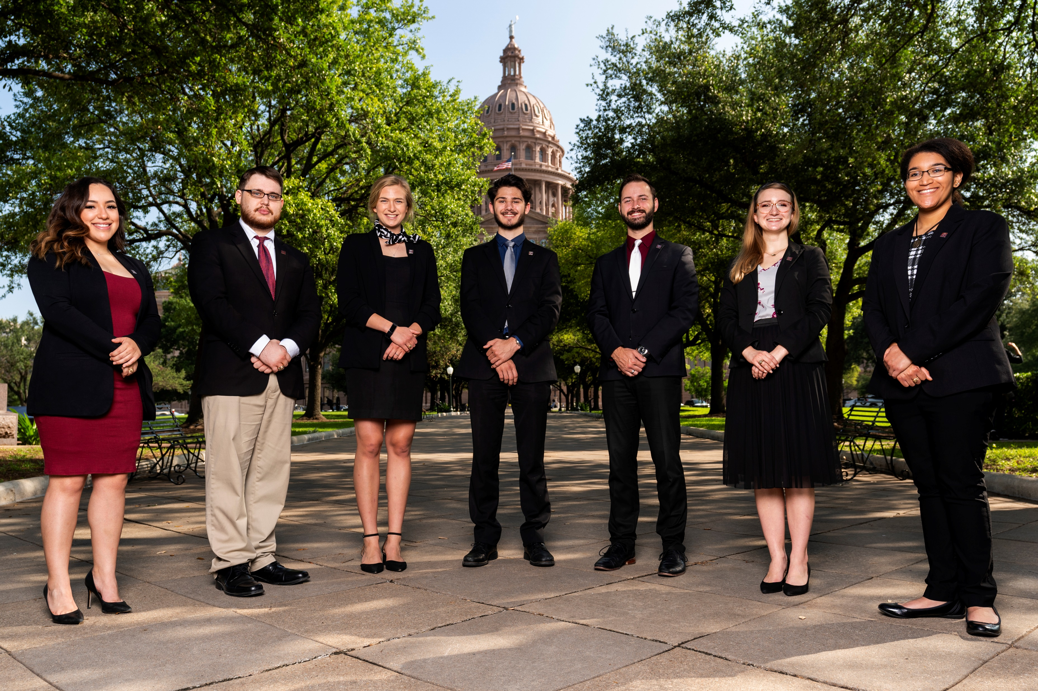
Connect with us
Website: anrp.tamu.edu | ppip.tamu.edu
Email: anrp@tamu.edu | ppip@tamu.edu
Phone: 979-845-3712
Office: Suite 515, Agriculture & Life Sciences Building
Instagram: @tamupolicyinterns
Twitter: @tamuANRP | @tamuPPIP
Facebook: @tamuANRP | @tamuPPIP

