Slide 1
Howdy!
Welcome to ANRP’s info session!
Here are some guidelines for this session:
  Please make sure that you are using your full name and not a screen name. We are taking attendance and you will be removed if you are not identified.
  All participants will be muted, and video disabled upon entry and throughout the session.
  If you have questions, please submit them via the live chat.
  Please be polite and respectful to all participants..
  We will answer your questions live at the end of the full presentation as time allows.

Slide 2
Agricultural & natural resources policy internship program
Become an Ambassador for Aggieland
anrp.tamu.edu

Slide 3
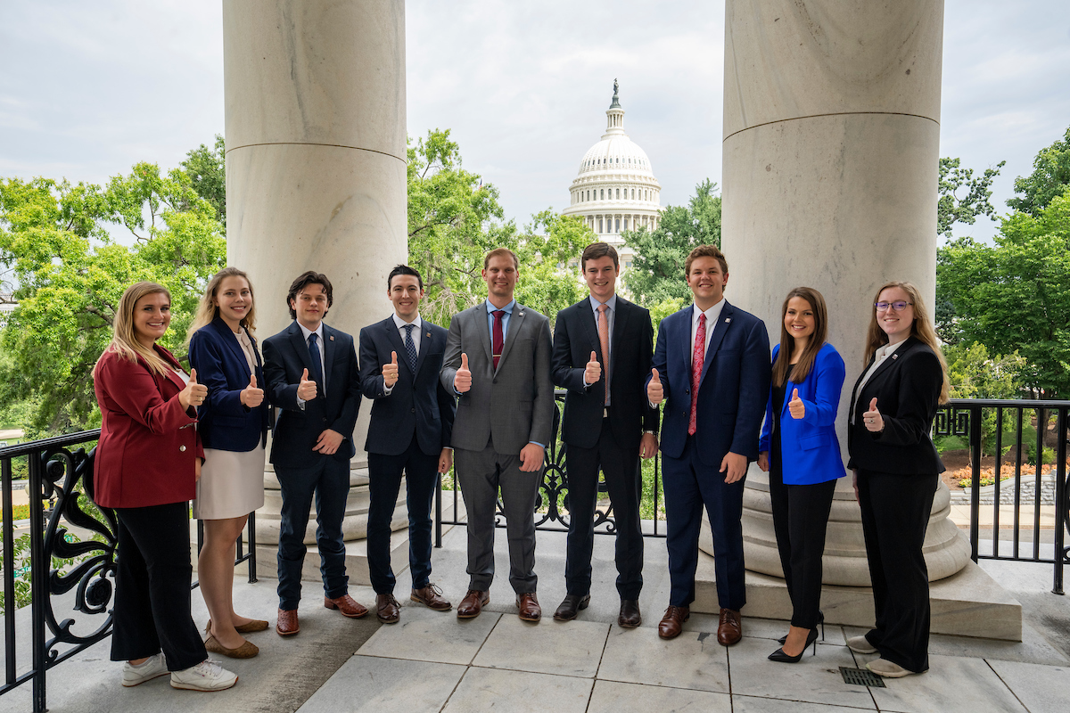
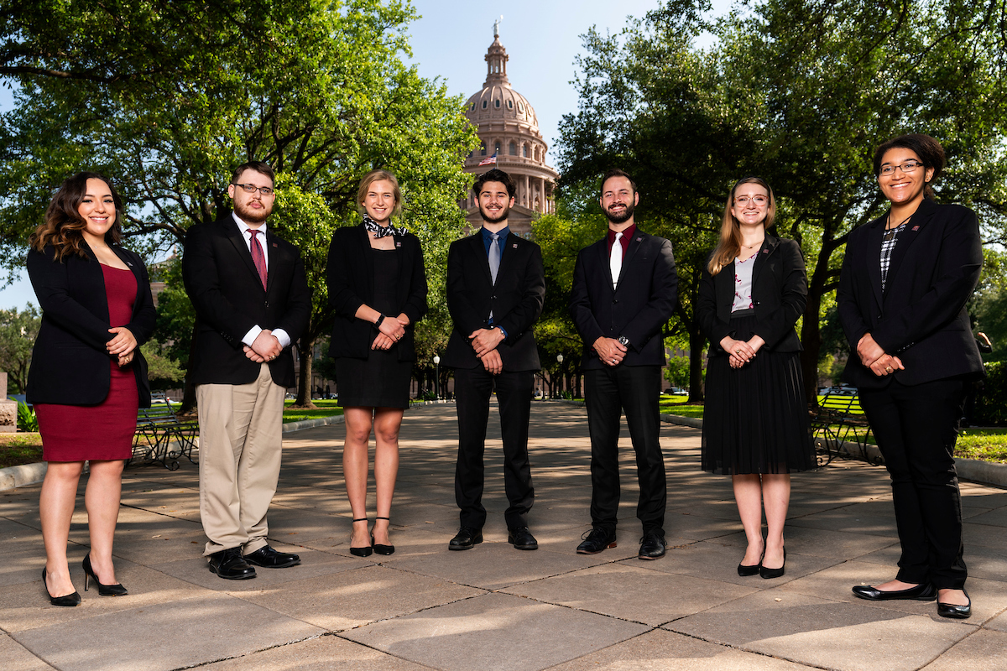
agenda
Program Overview
Program Benefits
Basic Eligibility
Application Components
Selection & Placement Processes
Question & Answers

Slide 4

Program overview
Overview
Policy-based internships in agriculture, natural resources, &/or life sciences
Full semester, all three terms (summer, fall, and spring)
Only for College of Agriculture & Life Sciences students
Locations
Washington, D.C.
International
Austin, Texas
  Legislative sessions only
History
Established spring 1990
Dr. Ron Knutson, an AGEC professor, founded the program
Over 1100 alumni

Slide 5

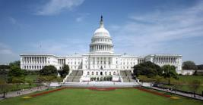

Aggie ambassador locations
Austin, Texas
Hosting Organizations may include:
Legislative Offices
State Agencies
Washington, D.C.
Hosting Organizations may include:
Congressional Offices
House Committee on Agriculture
Ag or Natural Resource advocacy groups
International
Hosting Organization:
Food & Agriculture Organization (FAO) of the United Nations

Slide 6
Potential offices
American Seed Trade Association
Farm Credit Bank of Texas
Farm Credit Council
Fertilizer Institute
House Committee on Agriculture (majority & minority offices)
Lix Cap
National Association of State Departments of Agriculture
National Association of Wheat Growers
National Cattlemen’s Beef Association – Public Lands Council
National Council of Farmers Cooperatives
National Farmers Union
US Department of Agriculture – Communications team
U.S. Representatives from the Texas delegation

Slide 7

Program benefits
 | Paid Internship | Housing Provided | Scholarship | Academic Credit | Networking | Resume Building | Training & Support | Knowledge of Policy Process
Washington, D.C.
Austin, TX
International
$500/month
$1000/month
$2000 su, $2500 sp/fa

Slide 8
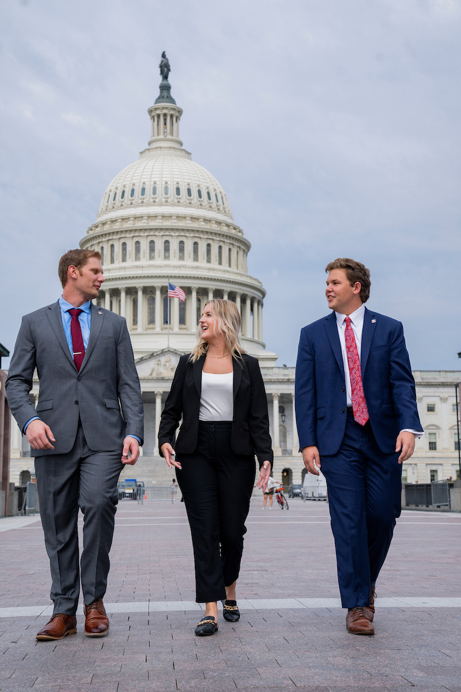
Basic eligibility
D.C. & Austin – must be a U.S. citizen
  Permanent residents &/or international students may apply for the Rome program.
Be in good academic and conduct standing at TAMU.
Minimum 2.25 cumulative GPR; 2.5 preferred.
Possess valid health insurance during the internship.
Currently enrolled as an undergraduate, master’s, or Ph.D. student in the College of Agriculture & Life Sciences.
Be able to attend all pre-departure events in College Station, Texas.
*some variation on eligibility exists by location, please visit website for details.

Slide 9
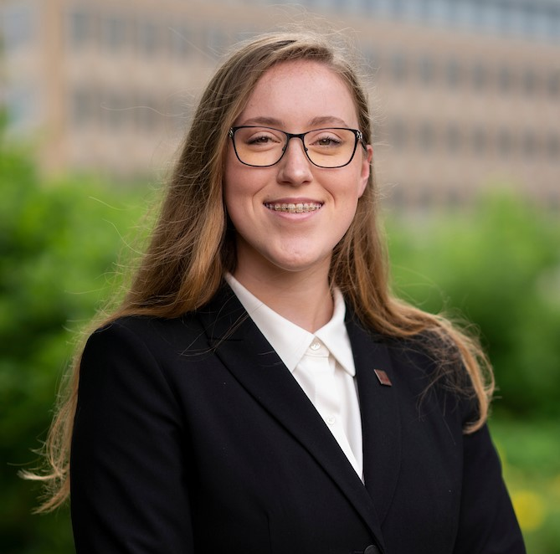

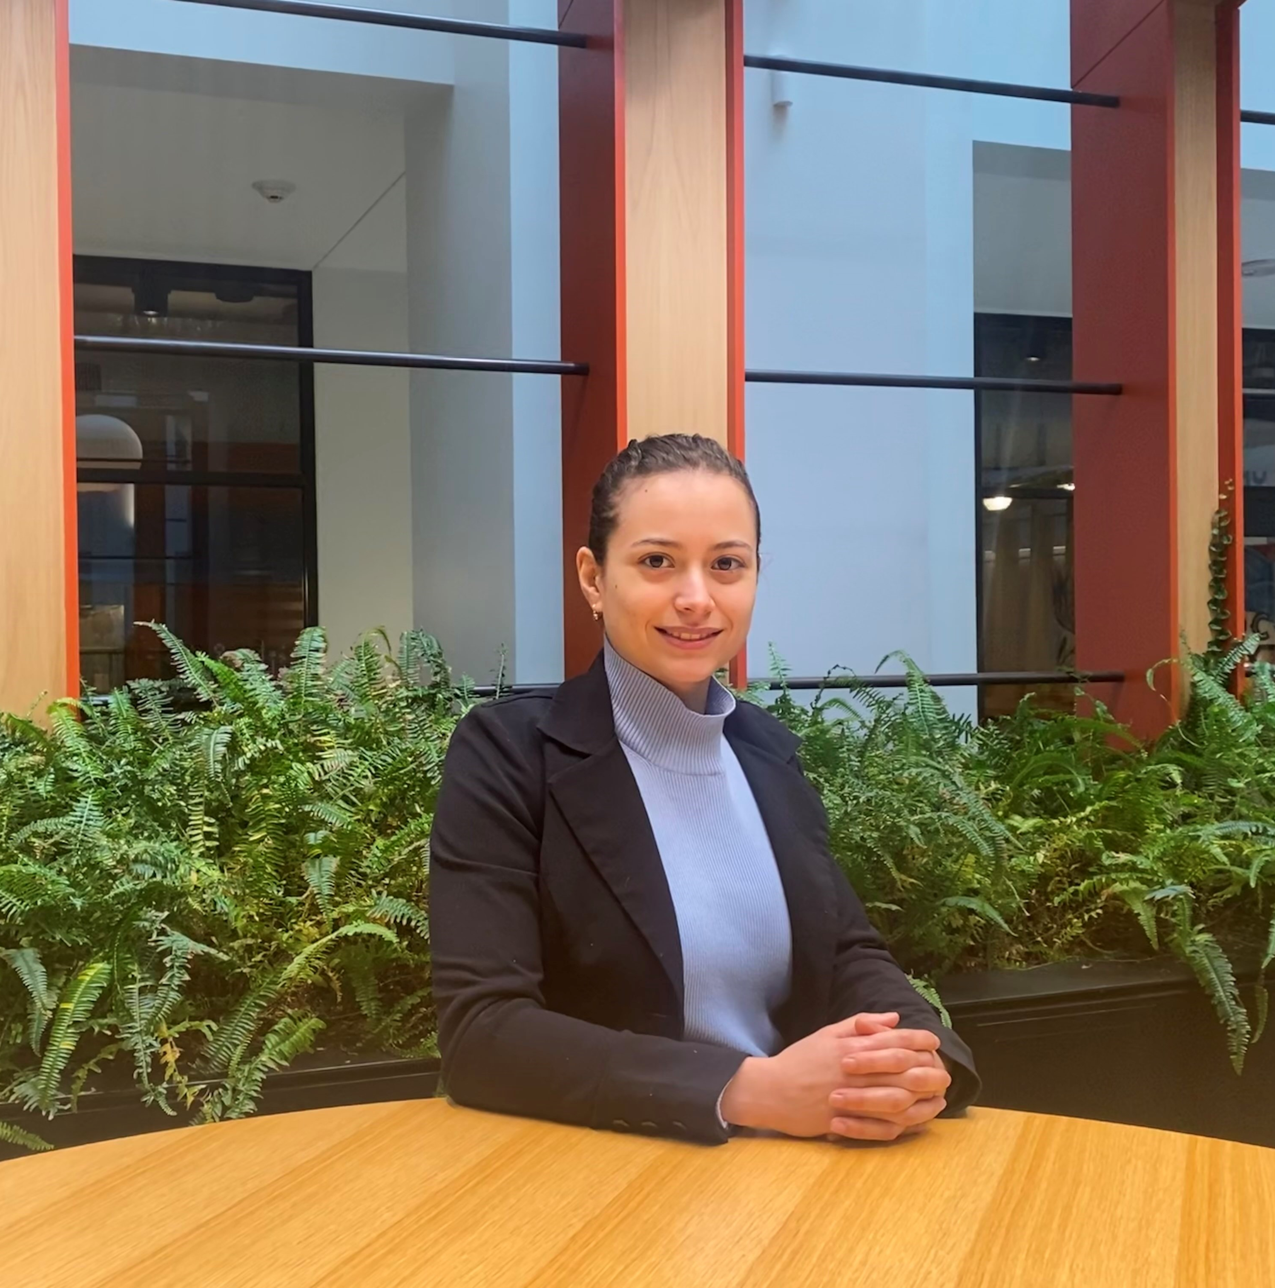


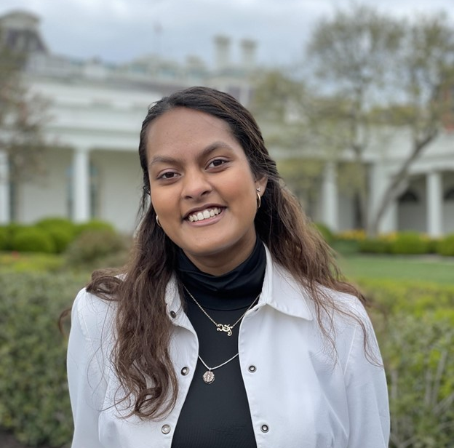
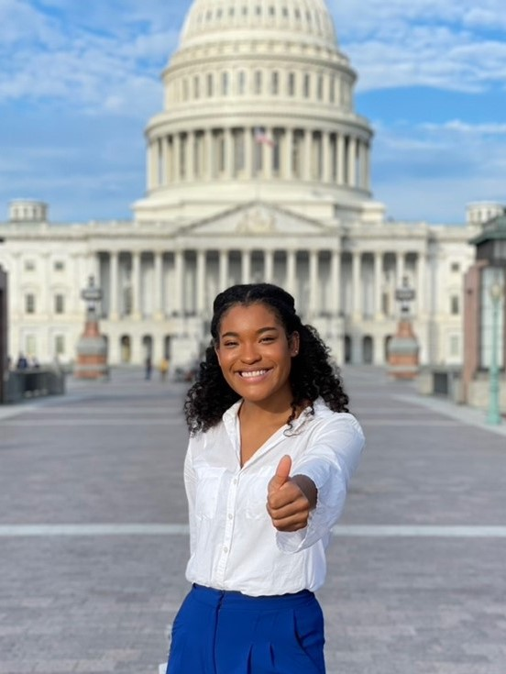
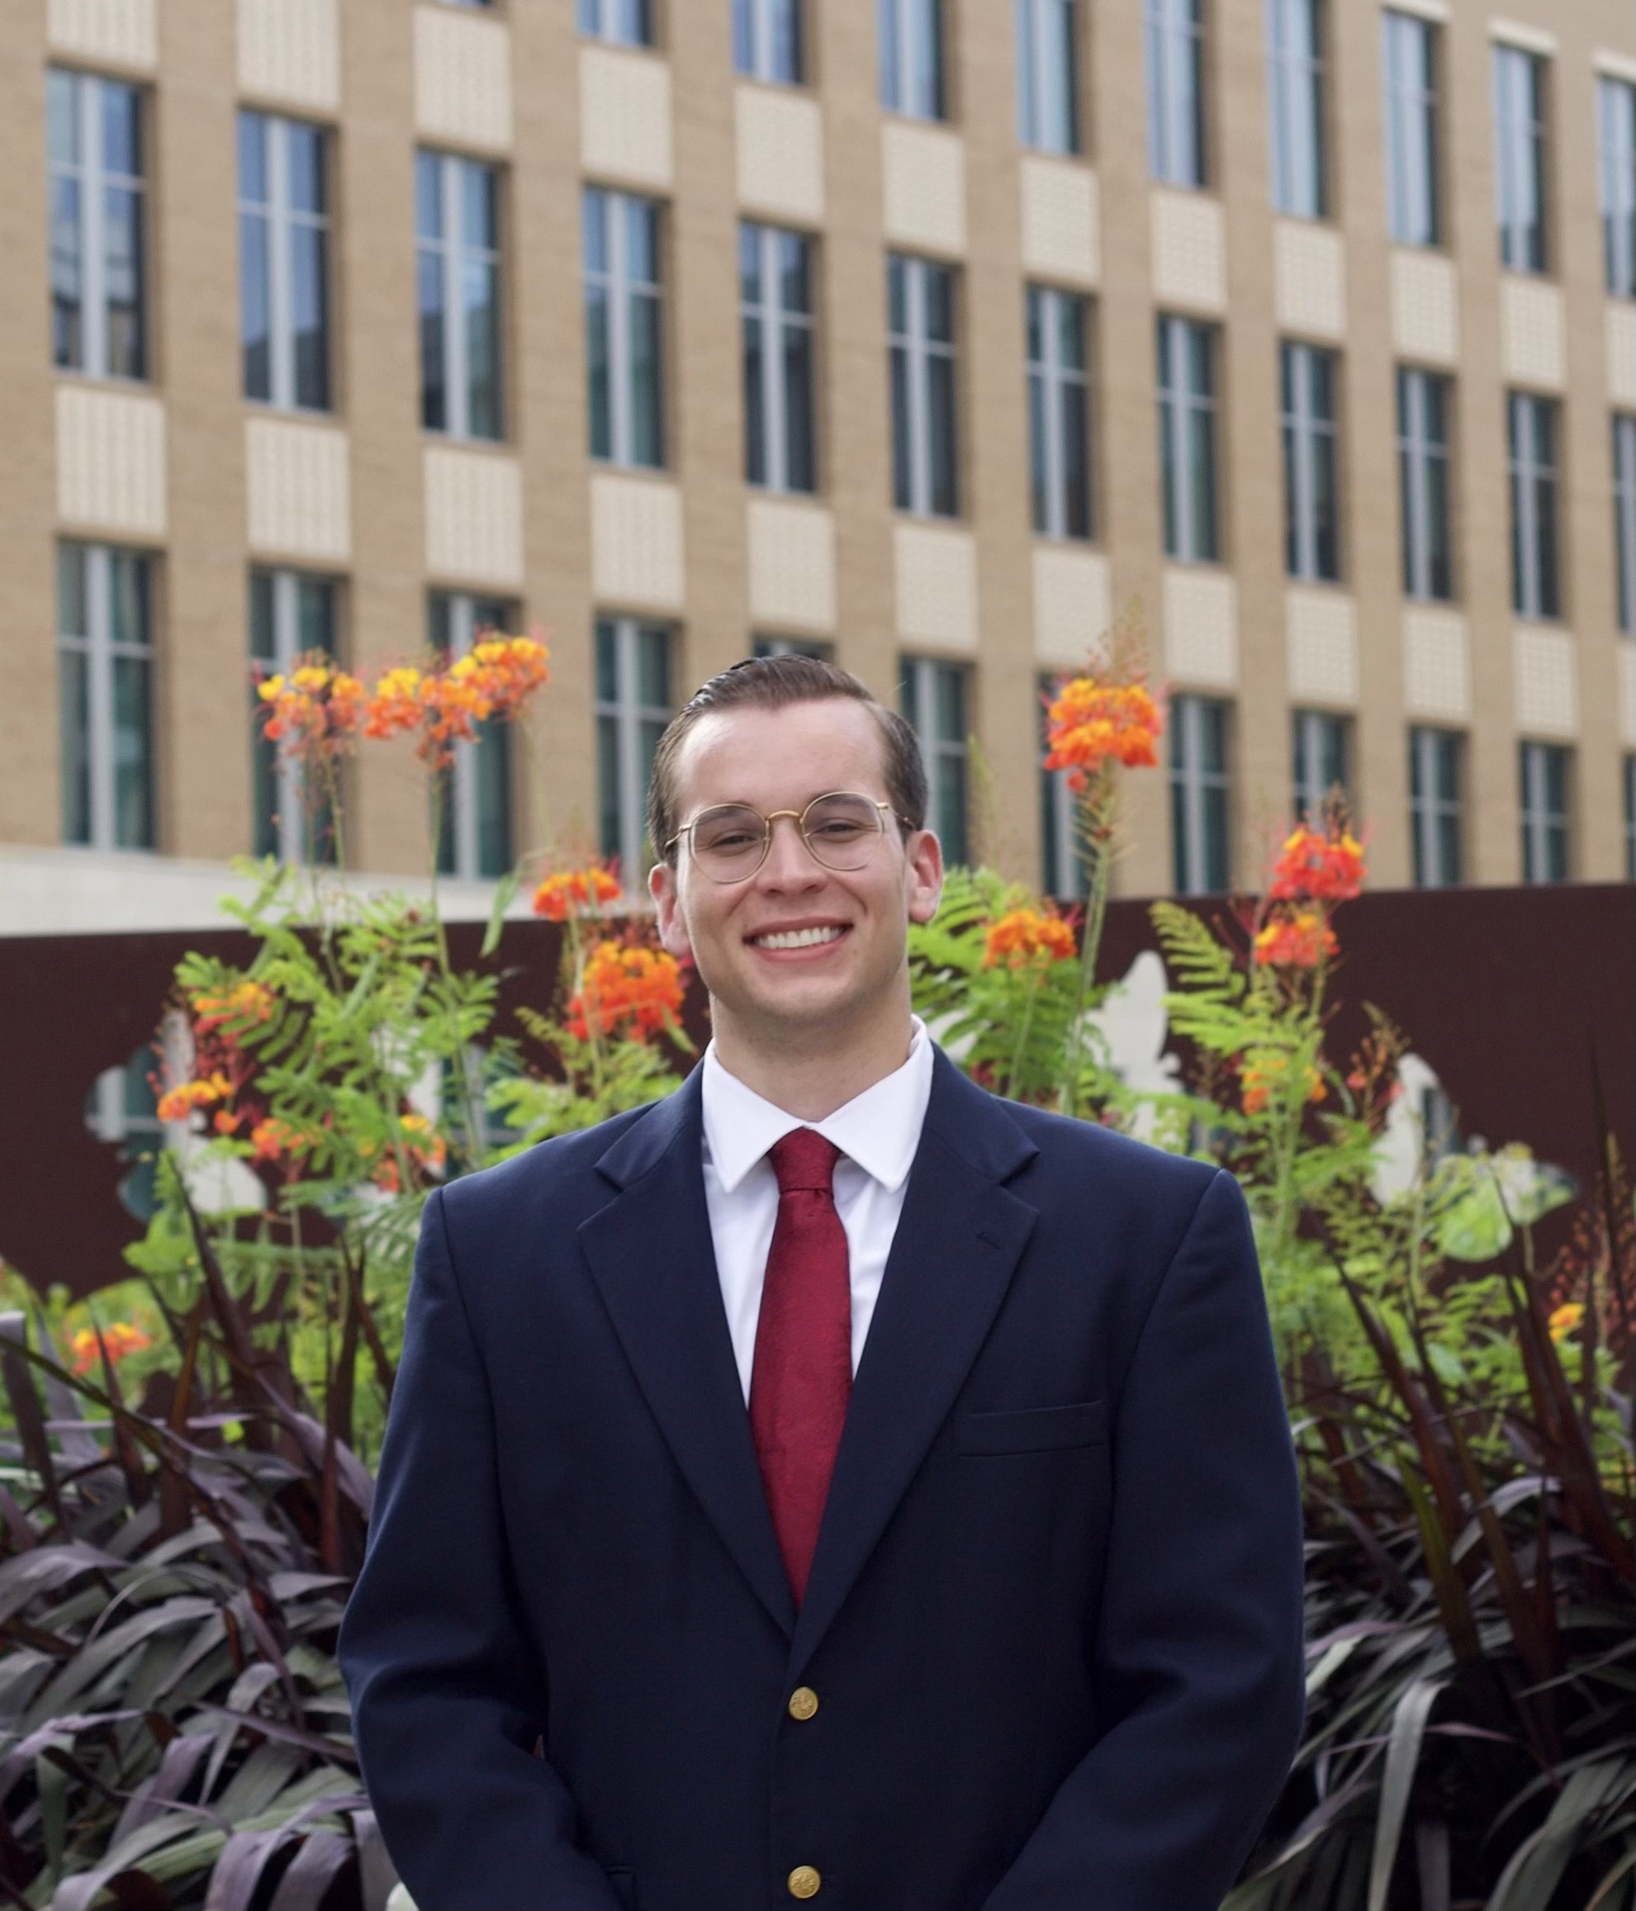
Aggies impact policy!
WFSC
BAEN
BESC
FIVS
RENR
AGBU
GENE
NUTR

Slide 10
Application components
A completed location-specific ANRP Internship Program Application
Cover Letter and Professional Resume
Policy/Issue Essay
  Location specific
Official college transcript(s)
  Transfer transcript only required if student is in first semester at A&M
Letter(s) of recommendation
  D.C. – 1 letter required
  Rome – 2 letters required

Slide 11
Selection process
Washington, D.C.
International
Austin,
Texas
1. Completed application
1. Completed application
1. Completed application
2. Sign-up for interview
2. Sign-up for interview
2. Sign-up for interview
3. Two15-minute interviews with faculty, staff, & donors
3. 15-minute interview with faculty, staff, & program donors
3. 15-minute interview with faculty, staff, & program donors
4. Applicant notification
4. Applicant notification
4. Applicant notification
5. Placement & feedback meeting
5. Placement & feedback meeting
5. Placement & feedback meeting
6. Securing an internship
6. Securing an internship
6. Securing an internship

Slide 12
Application deadlines
Austin, Texas
Term(s) Offered:
  Spring ’25 – applications open in August ’24
Washington, D.C.
Term(s) Offered:
  Spring & Summer ‘24 – applications due September 27 by 5pm
  Fall ’24 – applications open in January ‘24
International
Term(s) Offered:
  Spring ‘24 – applications due September 13 by 5pm
  Summer ’24 – applications due November 1 by 5 pm
  Fall ’24 – applications open in January ’24

Slide 13
Meet our former interns
What questions do you have?

Slide 14

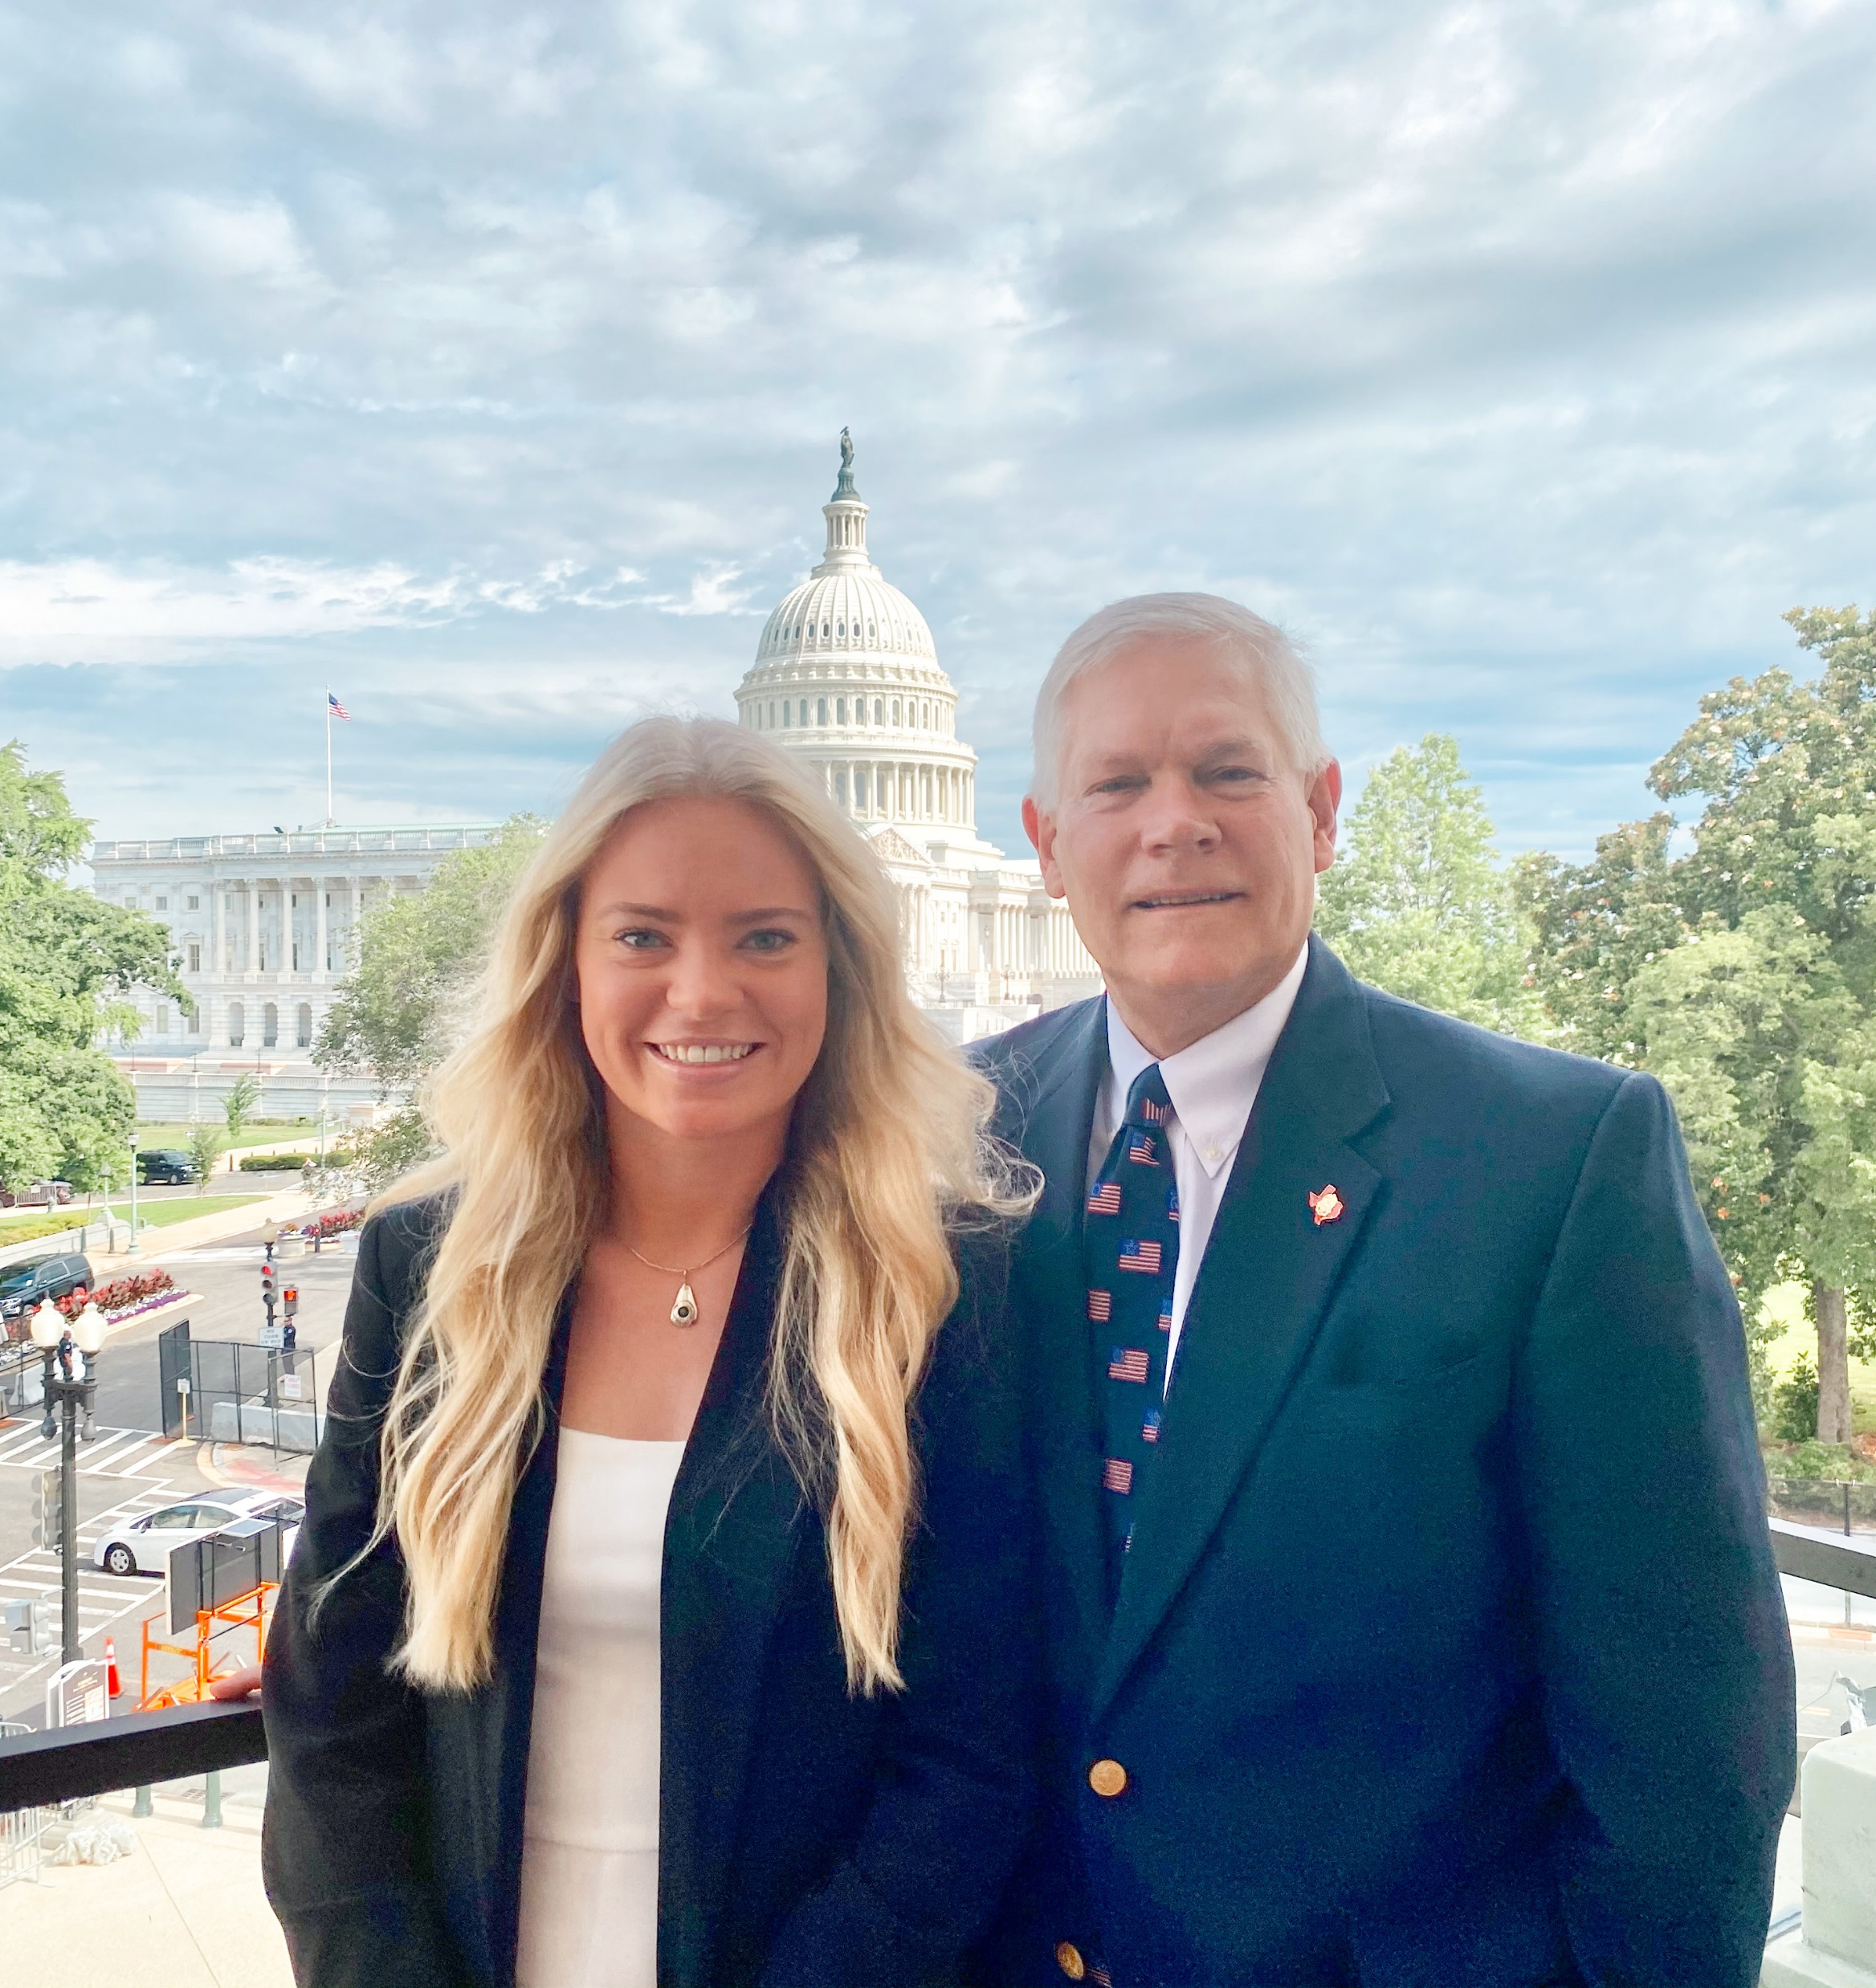




Connect with us
Website: anrp.tamu.edu
Email: anrp@tamu.edu
Phone: 979-845-3712
Office: Suite 515, Agriculture & Life Sciences Building
Instagram: @tamupolicyinterns
Twitter: @tamuANRP
Facebook: @tamuANRP

