Slide 1
Agricultural & natural resources policy internship program
Become an Ambassador for Aggieland
anrp.tamu.edu

Slide 2
Program overview
Overview
Policy-based internships in agriculture, natural resources, &/or life sciences
Full semester, all three terms (summer, fall, and spring)
Only for College of Agriculture & Life Sciences students
Locations
Washington, D.C.
International
Austin, Texas
Legislative sessions only
History
Established spring 1990
Dr. Ron Knutson, an AGEC professor, founded the program
Over 1200 alumni

Slide 3
Aggie ambassador locations
Austin, Texas
Hosting Organizations may include:
Legislative Offices
State Agencies
Washington, D.C.
Hosting Organizations may include:
Congressional Offices
House Committee on Agriculture
Ag or Natural Resource advocacy groups
International
Hosting Organization:
Food & Agriculture Organization (FAO) of the United Nations

Slide 4
Potential offices
American Seed Trade Association
Farm Credit Bank of Texas
Farm Credit Council
Fertilizer Institute
House Committee on Agriculture (majority & minority offices)
Lix Cap
National Association of State Departments of Agriculture
National Association of Wheat Growers
National Cattlemen’s Beef Association – Public Lands Council
National Council of Farmers Cooperatives
National Farmers Union
US Department of Agriculture – Communications team
U.S. Representatives from the Texas delegation

Slide 5
Program benefits
 | Paid Internship | Housing Provided | Scholarship | Academic Credit | Networking | Resume Building | Training & Support | Knowledge of Policy Process
Washington, D.C.
Austin, TX
International
$500/month
$1000/month
$2000 su, $2500 sp/fa

Slide 6
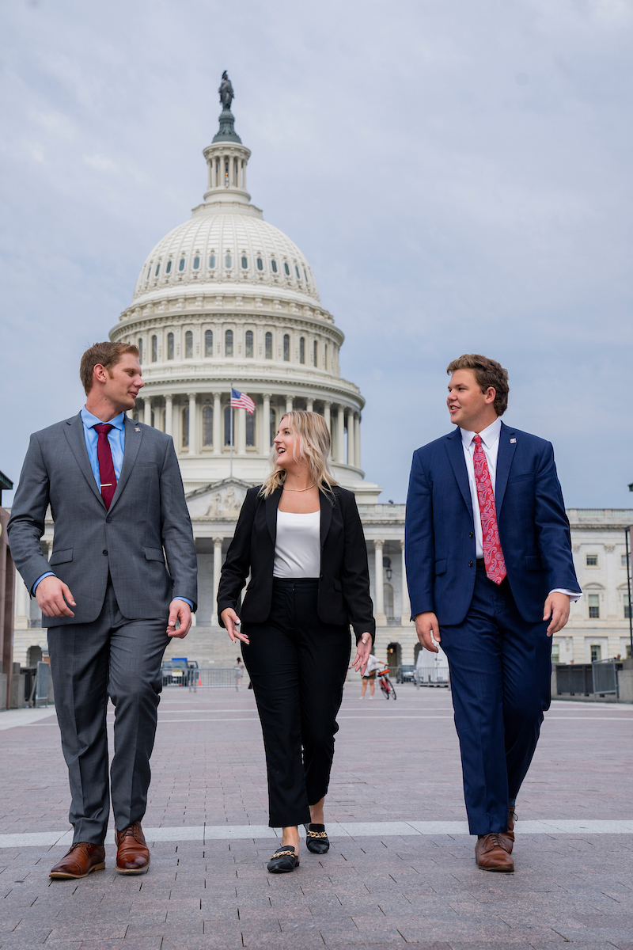
Basic eligibility
D.C. & Austin – must be a U.S. citizen
Permanent residents &/or international students may apply for the Rome program.
Be in good academic and conduct standing at TAMU.
Minimum 2.25 cumulative GPR; 2.5 preferred.
Possess valid health insurance during the internship.
Currently enrolled as an undergraduate, master’s, or Ph.D. student in the College of Agriculture & Life Sciences.
Be able to attend all pre-departure events in College Station, Texas.
*some variation on eligibility exists by location, please visit website for details.

Slide 7
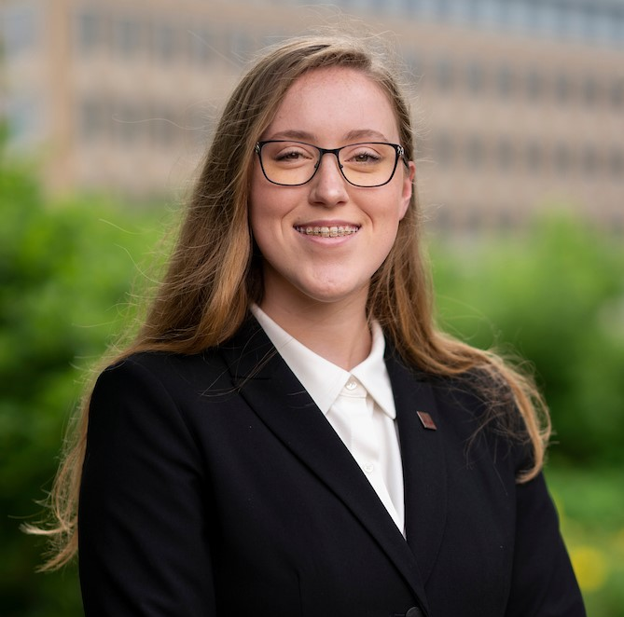
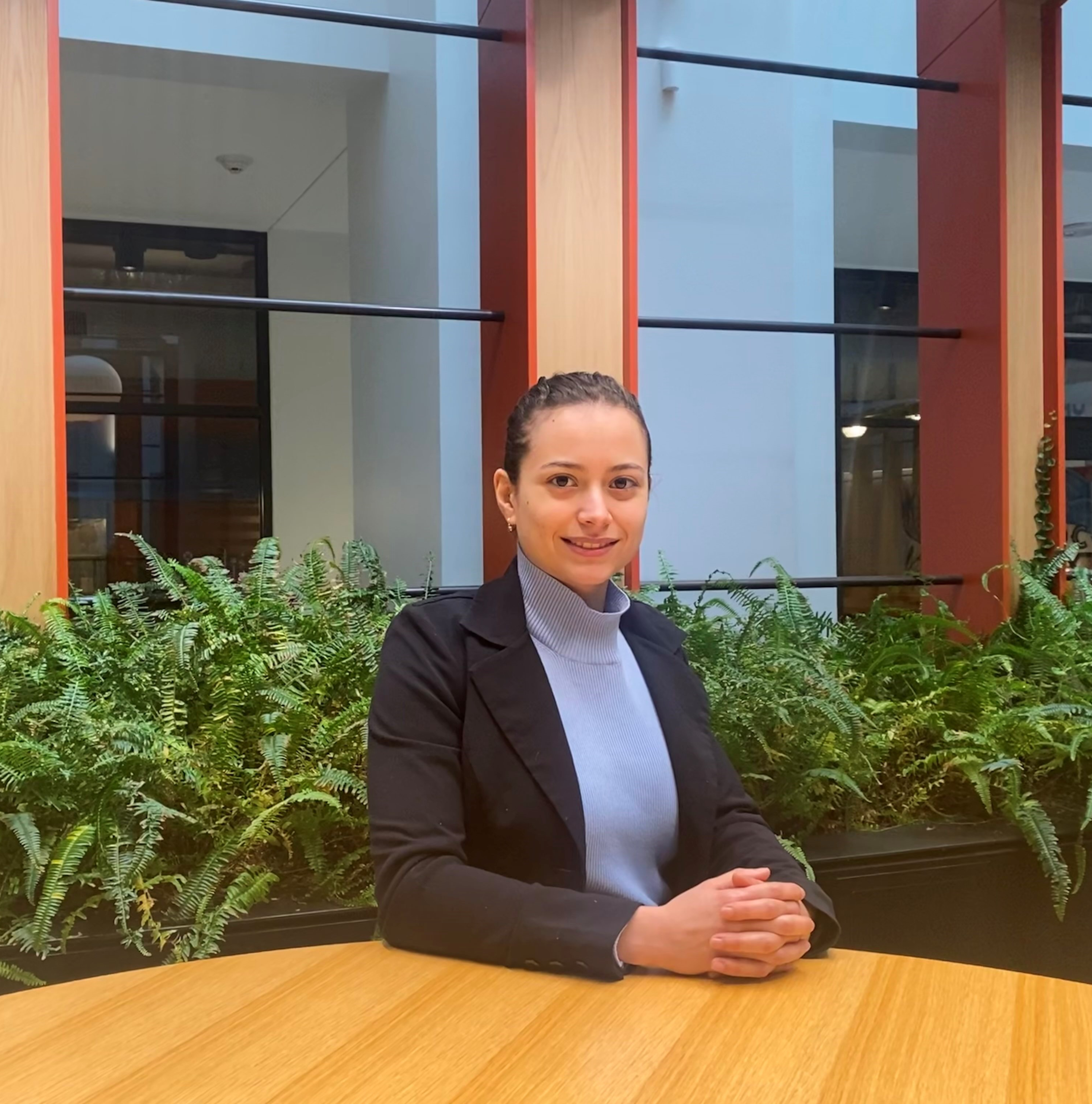
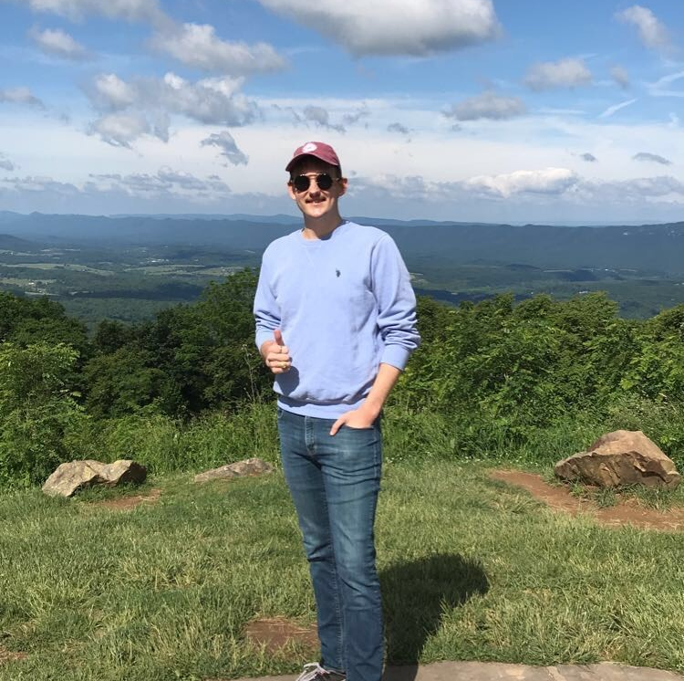
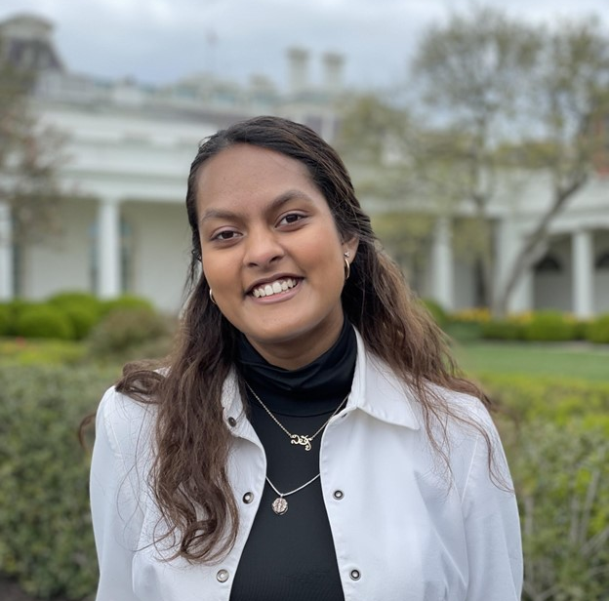
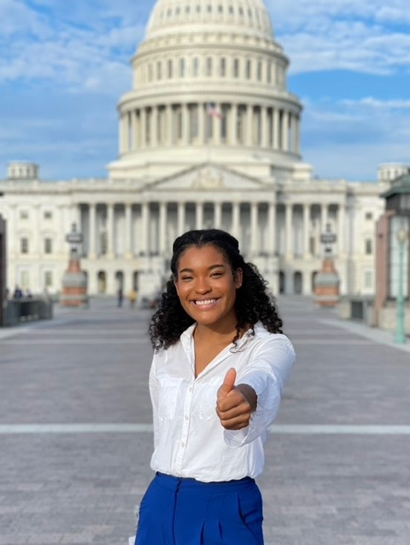
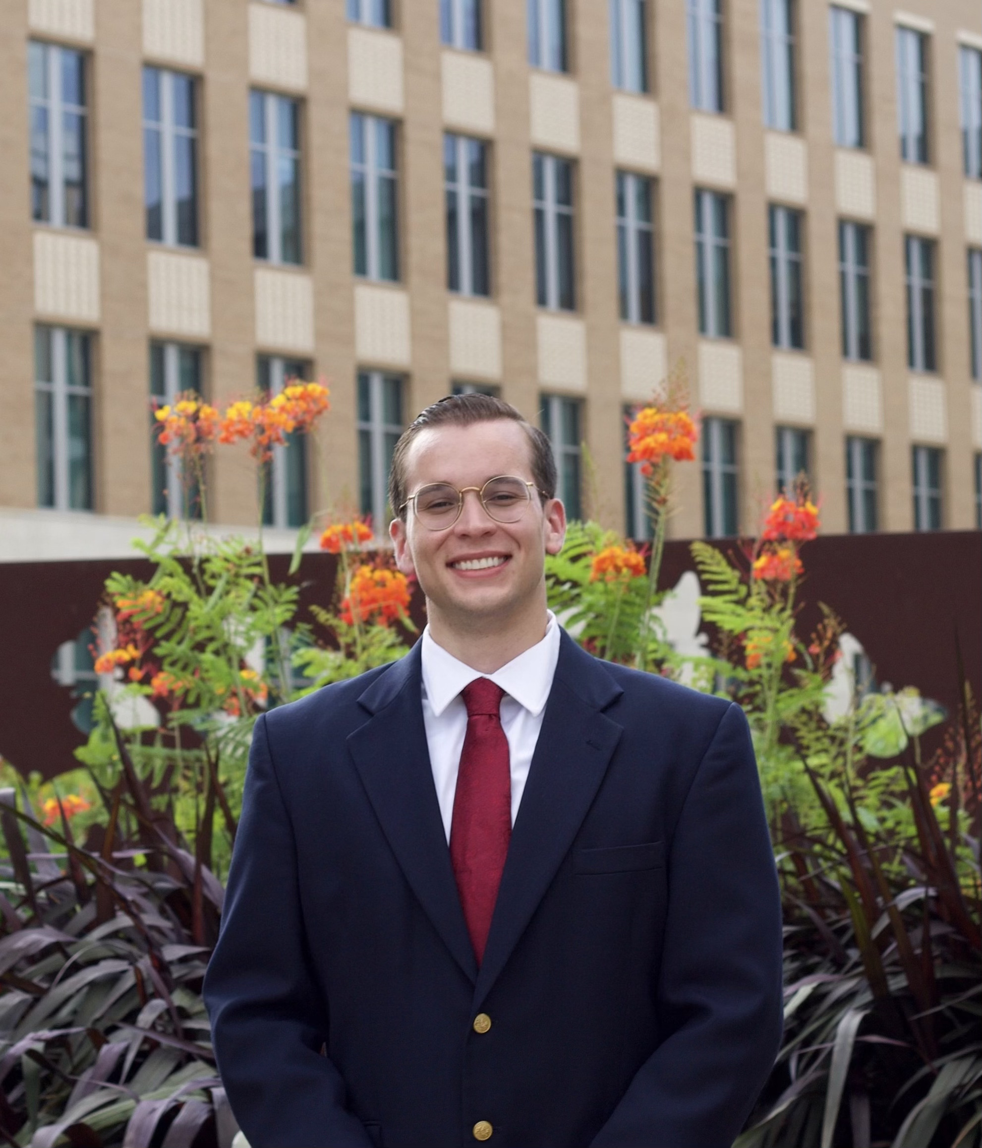
Aggies impact policy!
WFSC
BAEN
BESC
FIVS
RENR
AGBU
GENE
NUTR

Slide 8
Application deadlines
Austin, Texas
Term(s) Offered:
Spring ’25 – applications open in August ’24
Washington, D.C.
Term(s) Offered:
Spring & Summer ‘24 – applications due September 27 by 5pm
Fall ’24 – applications open in January ‘24
International
Term(s) Offered:
Spring ‘24 – applications due September 13 by 5pm
Summer ’24 – applications due November 1 by 5pm
Fall ’24 – applications open in January ’24

Slide 9
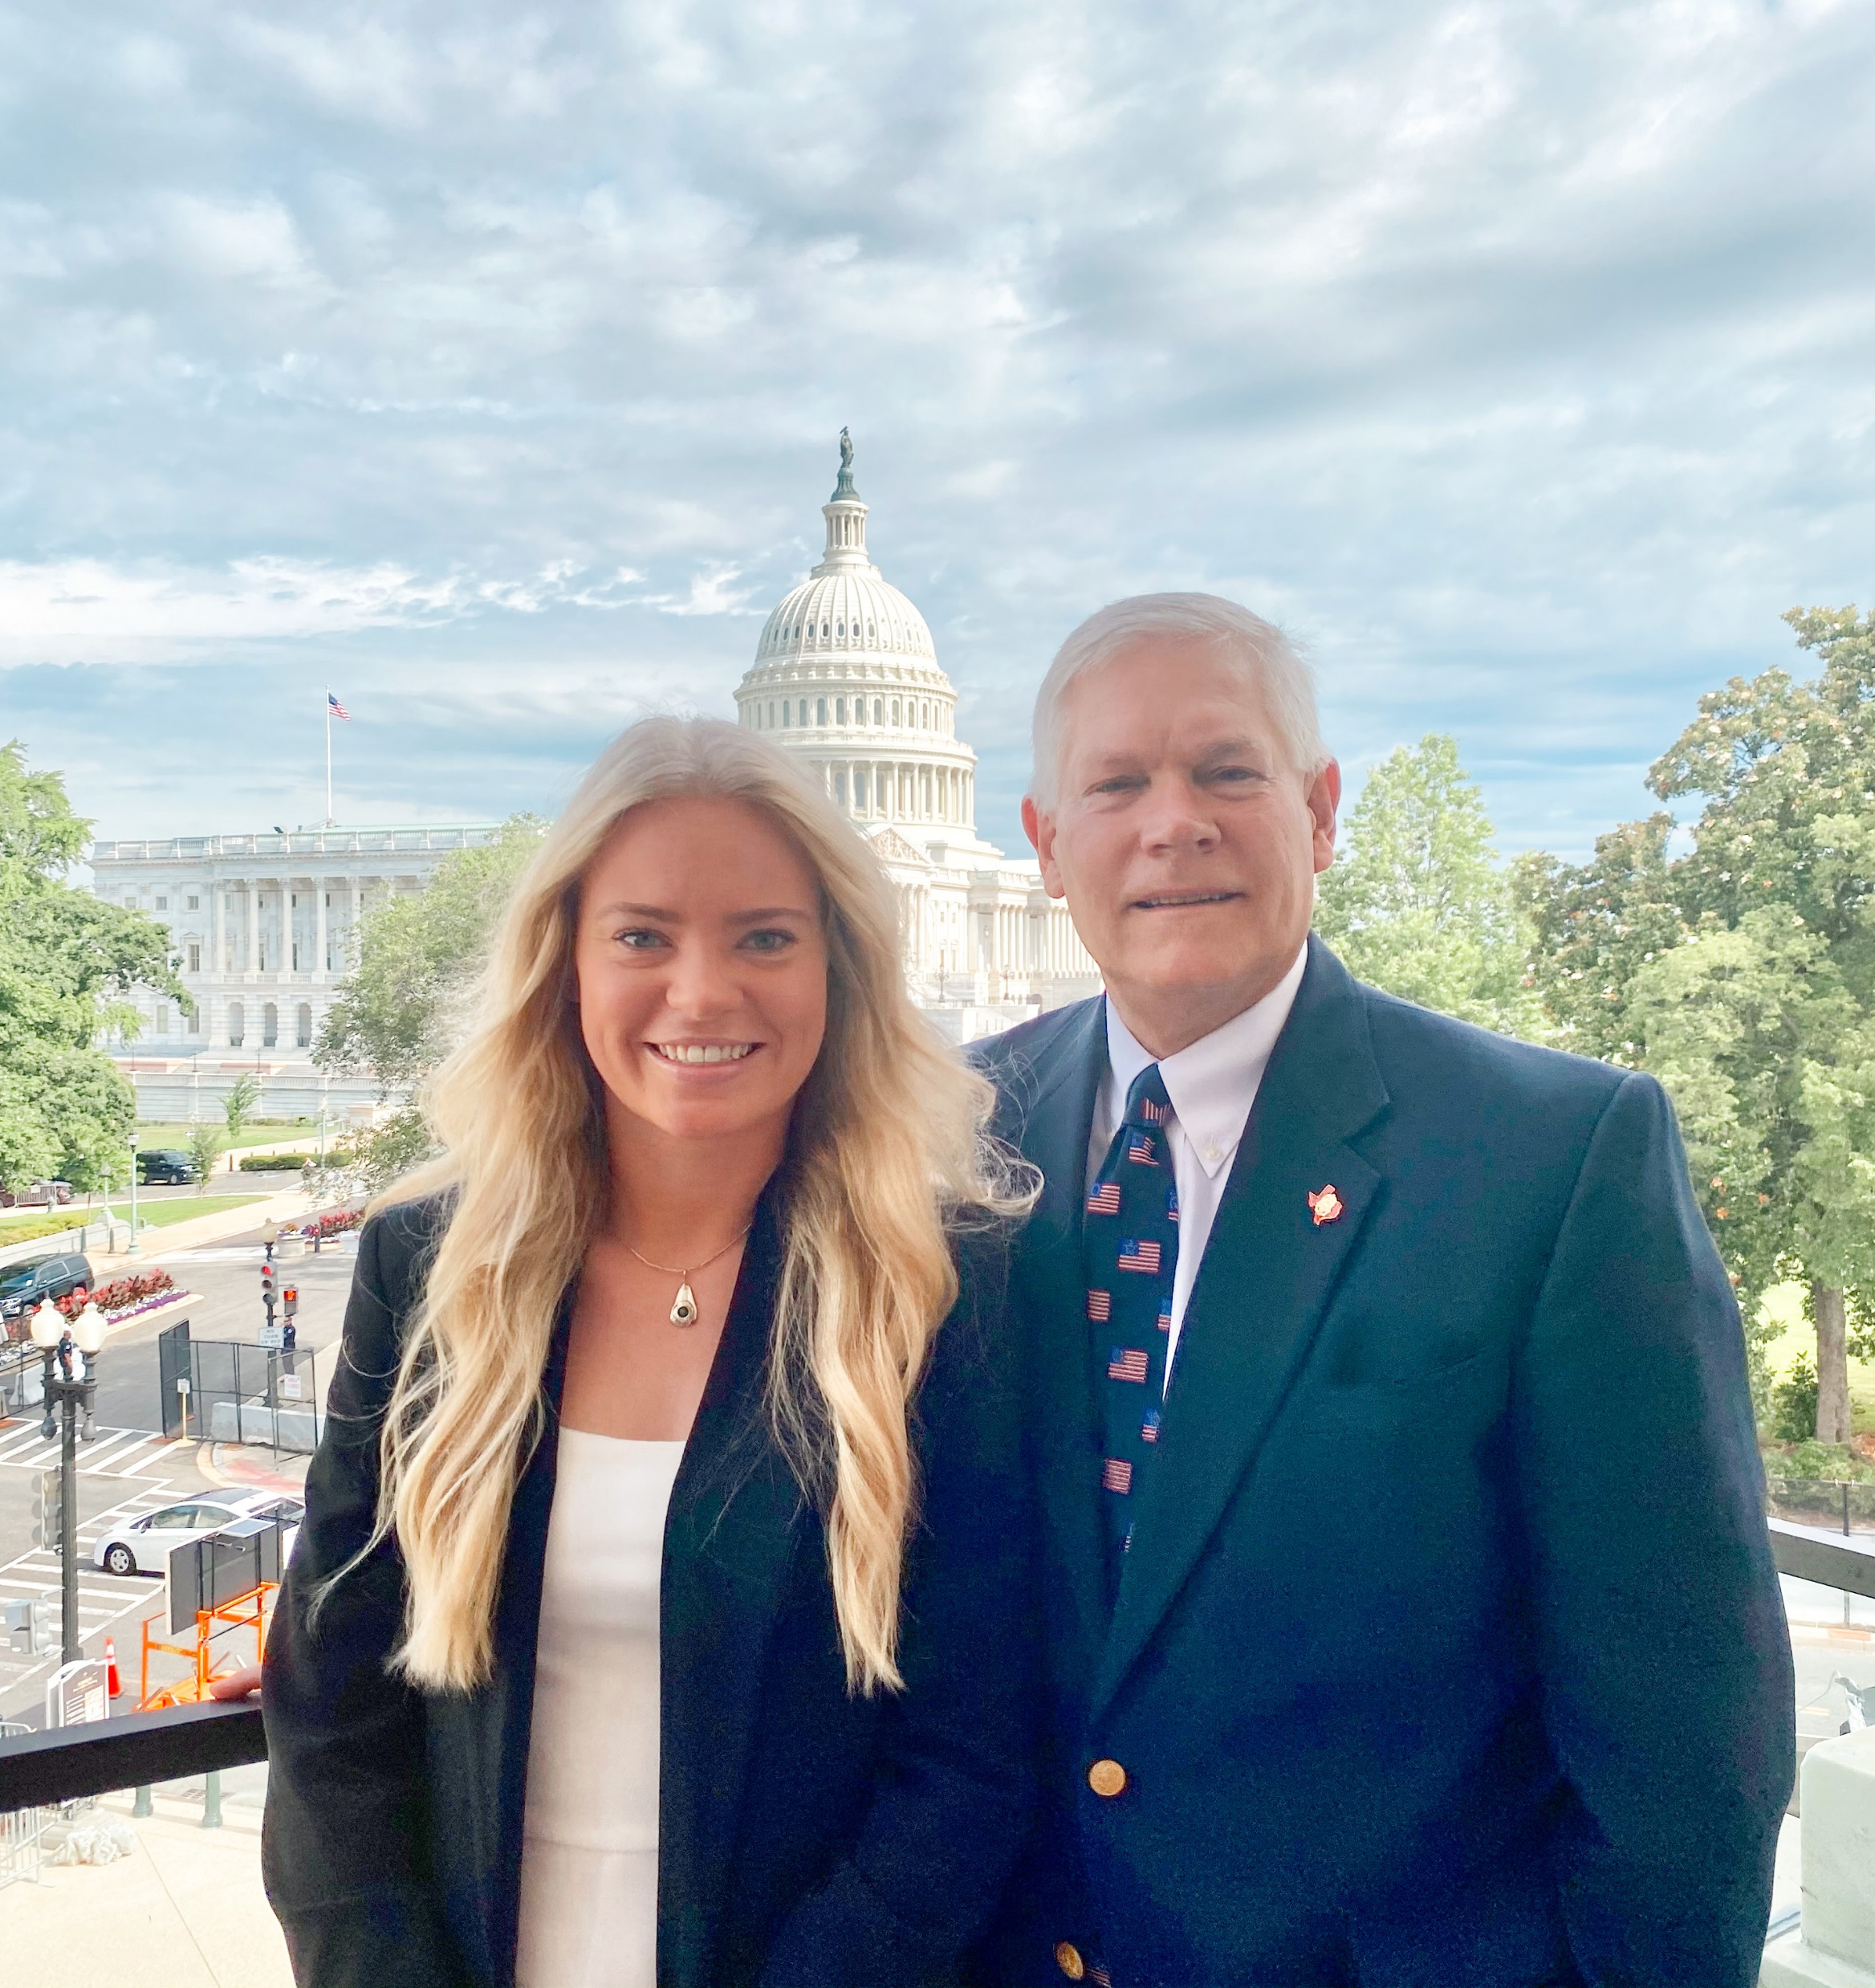
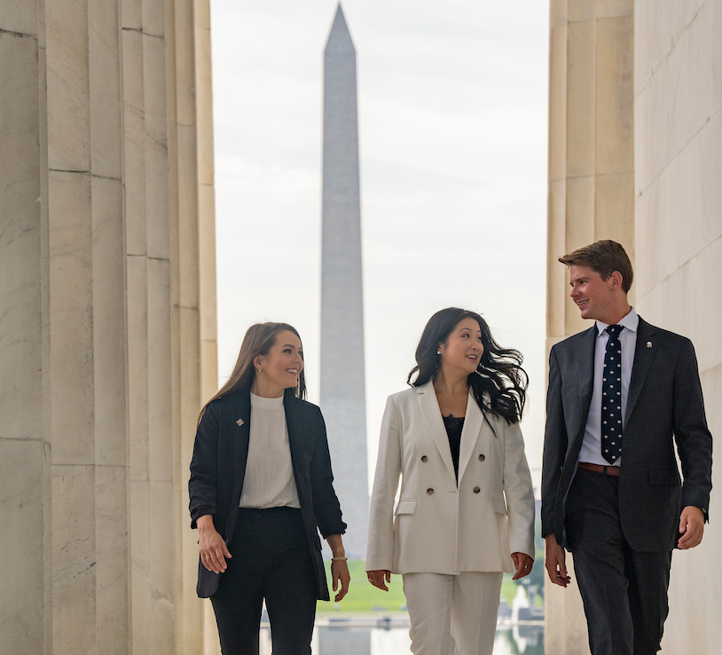
Connect with us
Website: anrp.tamu.edu
Email: anrp@tamu.edu
Phone: 979-845-3712
Office: Suite 515, Agriculture & Life Sciences Building
Instagram: @tamupolicyinterns
Twitter: @tamuANRP
Facebook: @tamuANRP

